Slide 1

acebook Comment Volume Analysis
Group 8:
Arunabho Chattopadhyay, Deepesh Jain, Khyati Mishra, Manasi Vivek Kher, Tejashree Pandit

Slide 2

Introduction
We are the analytics team appointed by Mr. Homer Simpson
He wants to start a new business and use Facebook as a medium of promotion
He wants to know how many comments will his ad posted on Facebook will receive
We analyzed the data on Facebook Comments to predict the average number of comments a post will receive
Determine the important factors to consider before posting an ad

Slide 3
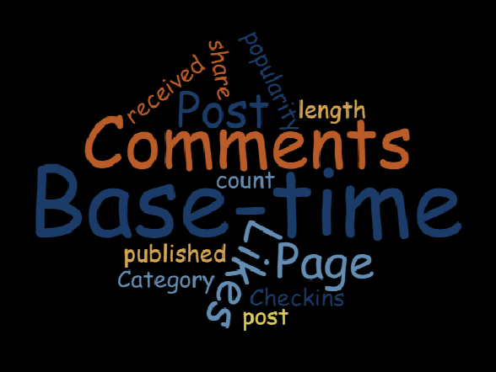
Features of Data Used for Analysis
Target Variable is continuous as we are predicting the average number of comments

Slide 4
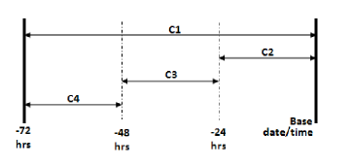
Base Time
Base Time (BT): Randomly selected time in order to simulate the scenario
C1: Total comment count before selected base time
C2: Comment count in last 24 hrs w.r.t to selected base time
C3: Comment count is last 48 hrs to last 24 hrs w.r.t to base time
C4: Comment count in first 24 hrs after publishing the post, but before selected base time
C5: The difference between C2 and C3

Slide 5
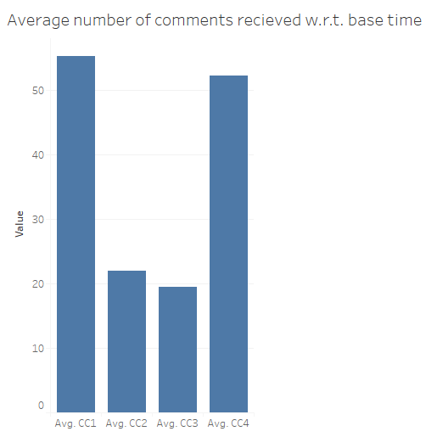
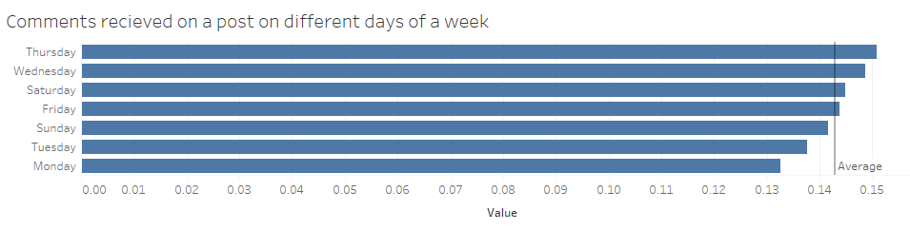
Visual Analysis of Data
Number of comments decline as we approach the base time
Maximum number of comments are received during 1st 24 hours of publishing the post
Legend
Avg CC1 – Total comments received before basetime
Avg CC2 – Comments received in last 24 hrs
Avg CC3 – Comments received in last 48 hrs to last 24 hrs
Avg CC4 – Comments received in 1st 24 hrs of publishing post

Slide 6
Data Study
The data was obtained from UCI: Machine Learning Repository website. This data is a second hand data
The dataset contains features extracted from Facebook posts. The task associated is to predict how many comments a post will receive

Slide 7
Data Exploration and Cleaning
Exploration: The data has over 40K rows. The target/dependent variable is “No. of comments”. We used box plot to identify any outliers in the data. We found none, we went further with exploration and used graph explore.
Cleaning: We performed regression on the entire dataset to identify significant variable. We found 10 significant variable.

Slide 8

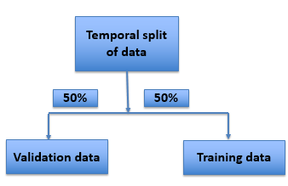
Data Exploration and Cleaning
We then performed data partition operation by splitting the data.

Slide 9
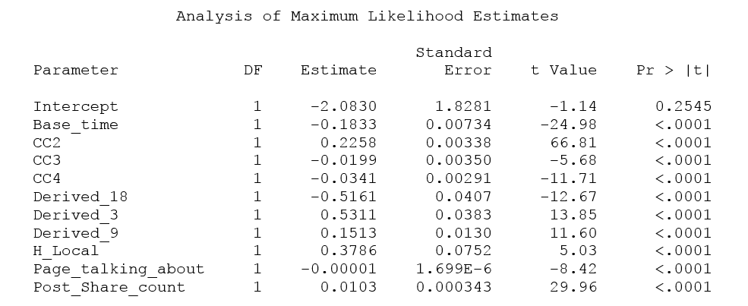

BI Models and Techniques
Data was partitioned as 50% training data and 50% validation data.
Regression was performed to determine significant variables

Slide 10
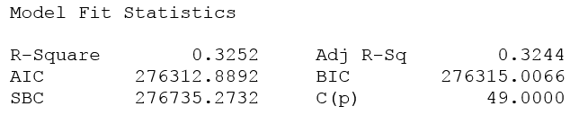
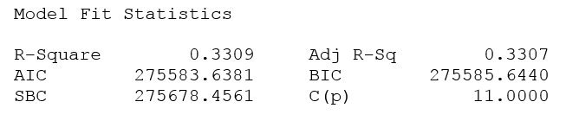
Regression
Another iteration of regression was performed using only significant variables
A slight improvement in fit statistics was observed

Slide 11
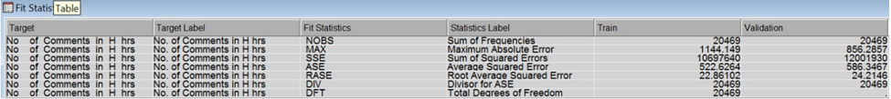
Decision Trees
Decision tree analysis was done using all variables
The following fit statistics was obtained after the analysis:

Slide 12
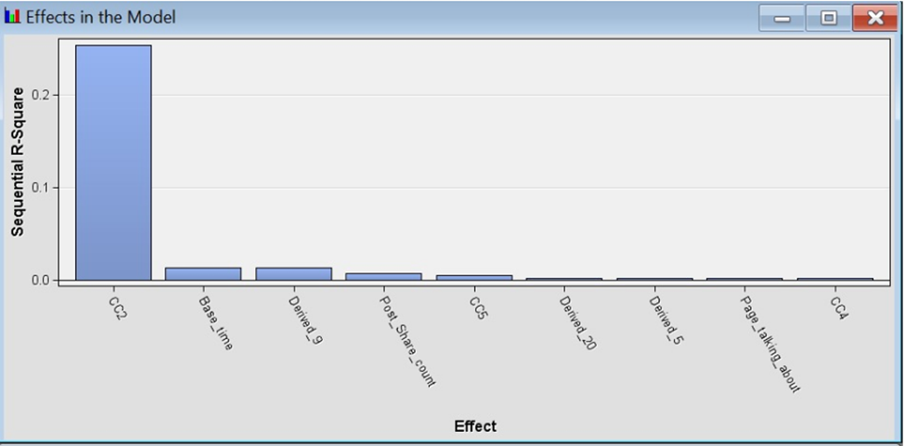
Decision Trees…
Decision tree analysis using only the significant variables obtained in regression
Decision tree analysis using the significant variables from variable selection node

Slide 13

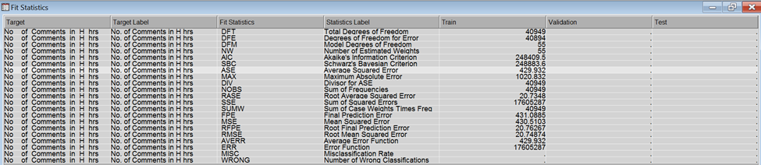
Neural Networks
Neural network analysis was done using all the variables
The fit statistic is as follows:

Slide 14
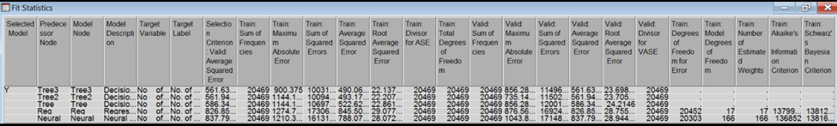
Best Fit Model
Model Comparator was used to figure out the best fit model
The result of model comparator is as follows

Slide 15
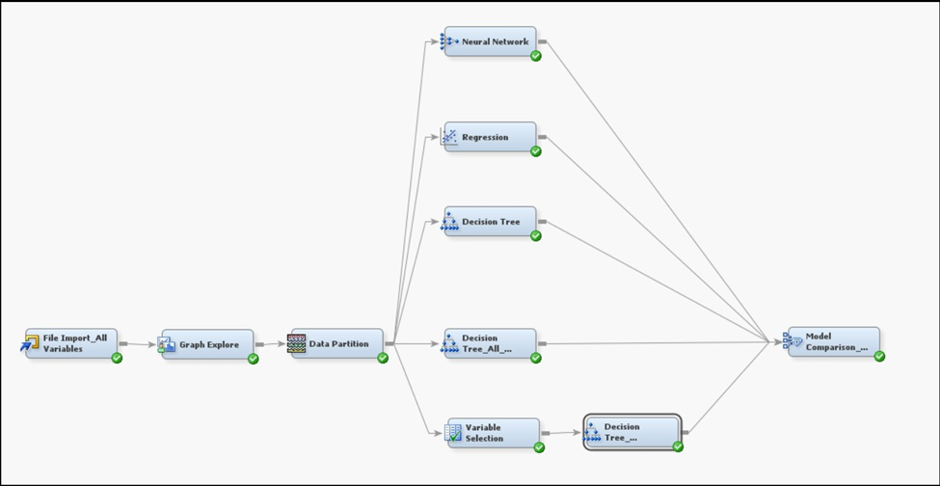
Conclusion
Important factors :
Base time
CC2
Final Model in SAS EM

Slide 16

Business Implications
The model can be used to analyze the response of the customers for a new product that is launched in the official page of the company.
Using the previous results, we can calculate the best time during which the user interaction is the most and the product should be launched at that time only.

Slide 17

Business Implications…
The model can be used by the tourism companies to find out which countries receive the maximum comments and where people are interested to visit.
Using the results, the companies can provide offers in order to maximize their sales.

Slide 18
Future Scope
We could further make use of Facebook likes and Facebook poll’s to study the response of audience.
With the introduction of new like option that includes options such as wow and sad we could further drill down our analysis.

